Slide 1
Free time
What kind of weekend person are you?

Slide 2


Slide 4
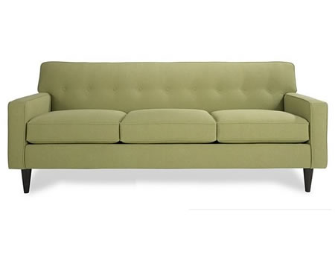
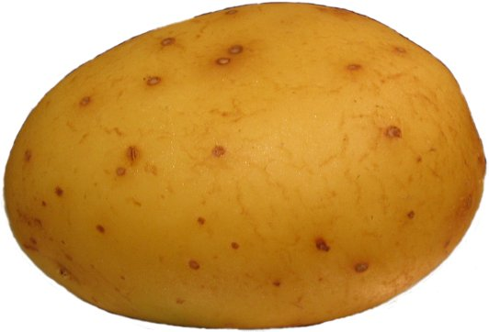
COUCH
POTATO

Slide 5
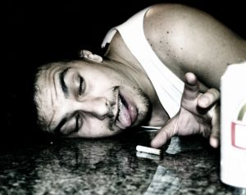

ALCOHOLIC
WORK

Slide 6
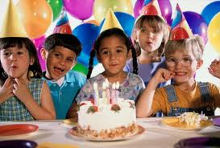
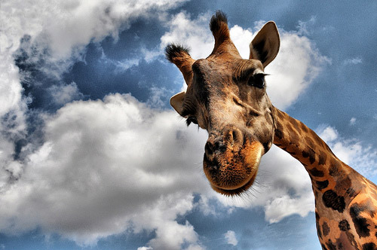
PARTY
ANIMAL

Slide 7
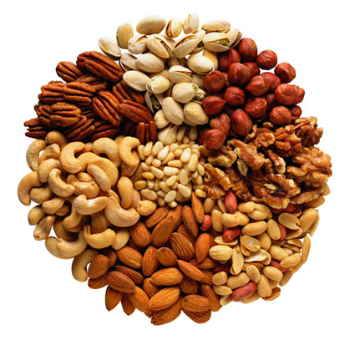
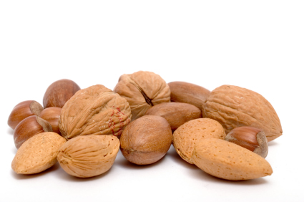
NUTS
NUTS

Slide 8
COUCH
POTATO

Slide 9
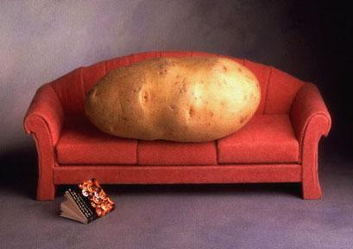
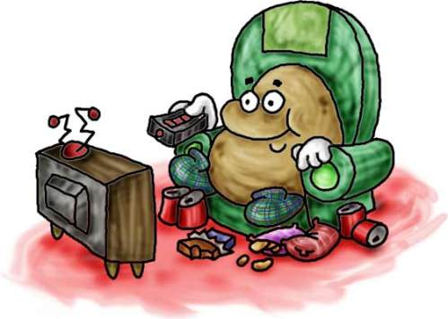
COUCH POTATO
?
?

Slide 10
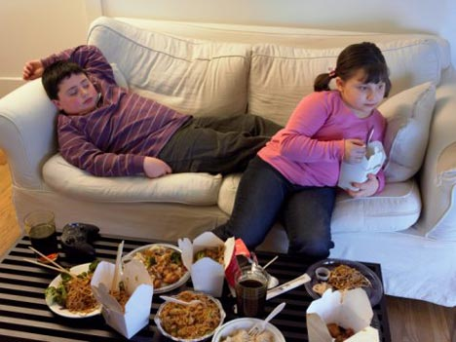
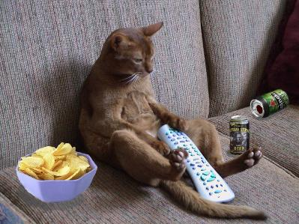
COUCH POTATO

Slide 11
ALCOHOLIC
WORK

Slide 12

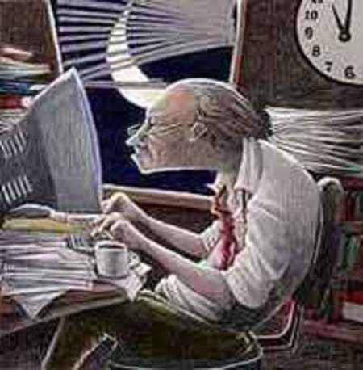
WORKAHOLIC

Slide 13
PARTY
ANIMAL

Slide 14
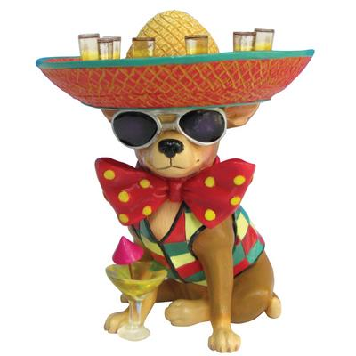
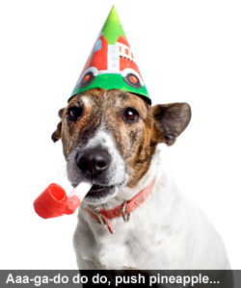
PARTY ANIMAL
?
?

Slide 15
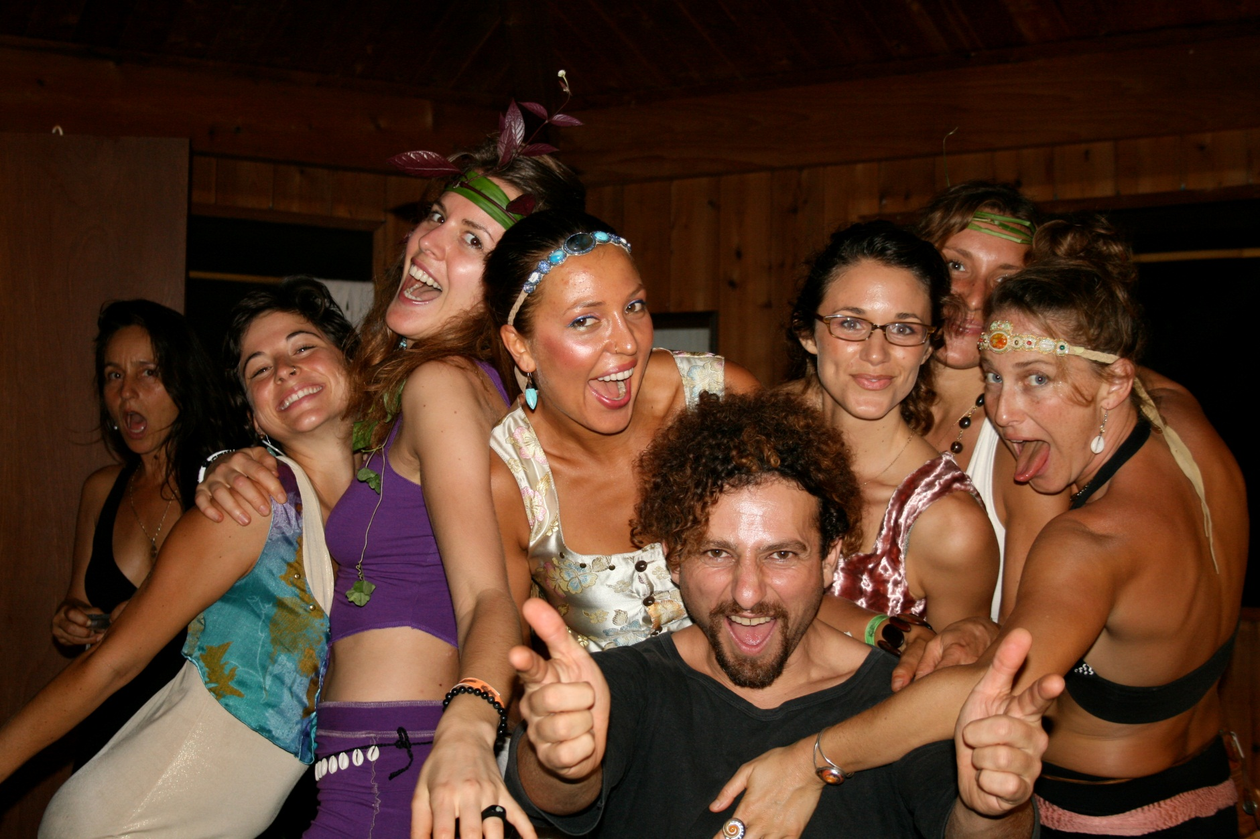
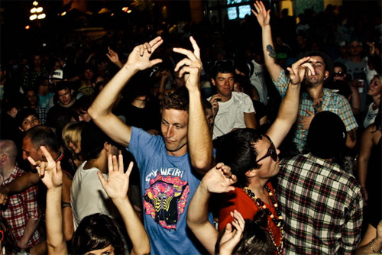
PARTY ANIMALS

Slide 16
NUTS
NUTS

Slide 17
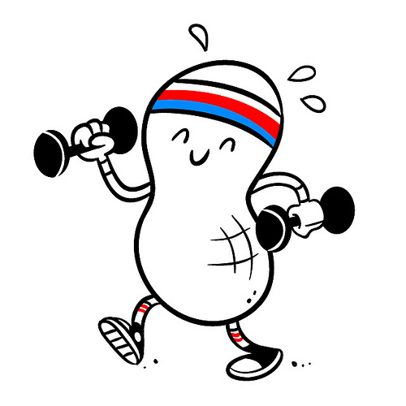
HEALTH NUT
?

Slide 18

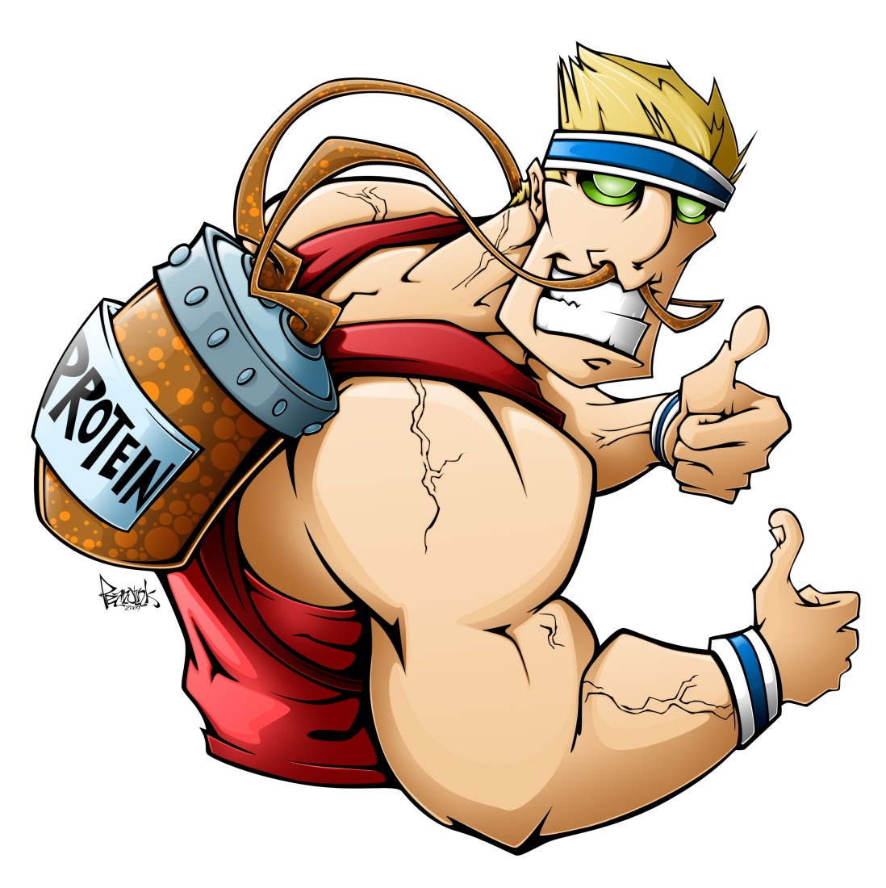
HEALTH NUT

Slide 19

COUCH POTATO
PARTY ANIMALS
HEALTH NUT
WORKAHOLIC

